Slide 1
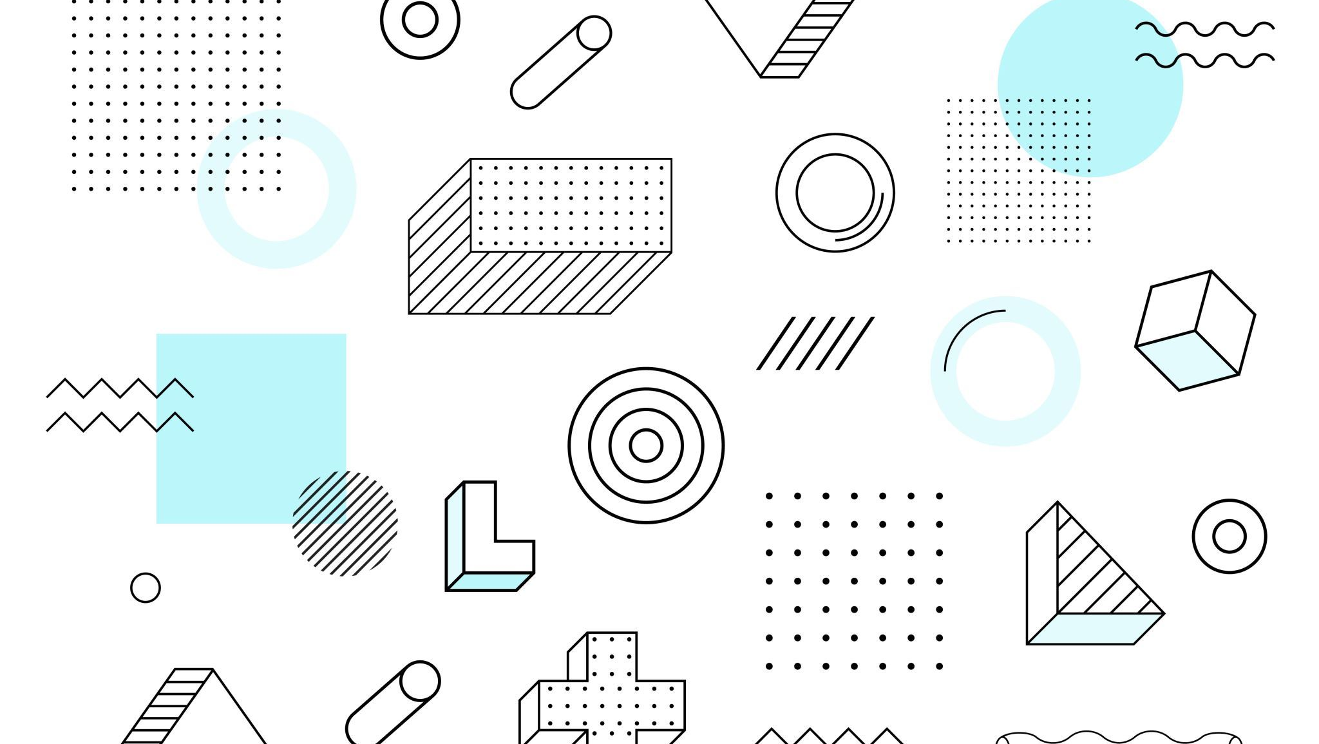
Year End Project
Syon Deb, Annika Vuppala

Slide 2
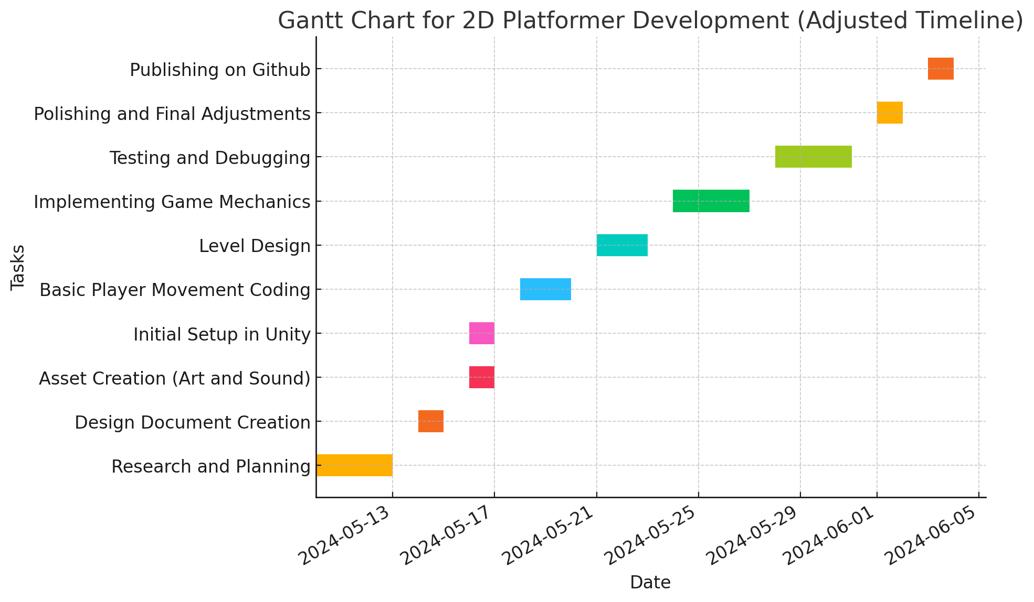
Gantt Chart

Slide 3
About the 2D Platformer
Our game is a multi-level two dimensional platformer video game, in which there are enemies, traps, puzzles, and fighting. The player is a dragonborn creature that has the ability to cast fire balls at the push of a button. The player may also wall jump and run.

Slide 4
Error Handling
Staying within the game boundaries:
The walls are coded so the player can’t cross them and will stay in the game space.
Player Jumping Errors:
The player’s z-axis is turned off to prevent the player from flipping over. The z-axis is not needed as it is a 2D game.
Extra Health:
The amount of health a player can receive is capped at 3. This prevents abuse of the health boosters.

Slide 5
Process
We spent everyday from the month of May working on the game. We have spent the initial days researching Unity, and coding, and animation. We then planned the game mechanics, and the gameplay. We began development and started with character movement, and animation, and level design. We then started adding special movements such as running, jumping, and wall-jumping. We also added animations for traps, health boosters, and casting fireballs.

Slide 6
Conclusion
As we come to the end of our 2D platformer development journey, we consider the enormous growth and learning that have characterized each step, from careful planning and research to cooperative coding, imaginative asset design, and rigorous testing. We refined our technical abilities and optimized our workflow with Unity and GitHub to guarantee a seamless, engaging player experience. This project has improved our ability to collaborate as a team as well as our technical and creative skills. We are happy with our achievements and eager to work on new and improved projects in the future. I appreciate your time and assistance.

